Slide 1
Lecture 2
Binary representation and arithmetic
More about reference data types
Abstract Data Types – prepare for lab 1
Arrays and the ArrayList ADT
Boxing and unboxing
( primitive ← → reference )

Slide 2
Quick Decimal <-> Binary conversion
Decimal to binary:
Take highest power of 2 less than the value.
Subtract that power from value.
Repeat until value is zero.
short age = 88;
88-64 = 24 ;write down bit in 64 position (2^6)
24 – 16 =8 ; write down bit in 16 position (2^4)
8 – 8 = 0 ; write down bit in 8 position (2^3)
Binary to decimal:
Write the decimal power of 2 above each one bit position.
Add up the powers of 2.

Slide 3
Unsigned integer Data
Positive integer only – not supported by Java:
C: unsigned short = 16 bits, unsigned int = 32 bits
No sign bit
Store its base-two representation in 16 or 32 bits
short age = 88;

Slide 4
Binary addition
Computer addition: very simple for unsigned (positive numbers)
Example:
7 = 0111
+ 3 = 0011
Use XOR for each column:
If the number of ones is EVEN, the sum is 0, otherwise the sum is 1.
Procedure: Rightmost column of bits: 1 XOR 1 = 0.
Write down result (0).
If there is a carry (two 1 bits in column),
place carry over next column to the left.

Slide 5
Problems with Integer Representation
Limited Capacity — a finite number of bits
An operation can produce a value that requires more bits than maximum number allowed.
This is called
overflow .
So none of these is a perfect representation of (mathematical) integers — can only store a finite (sub)range of them.

Slide 6
Signed numbers
Signed integer: type int (and variations) in C++
Store in a fixed number w of bits,
using one of the following representations:
2’s complement
Signed-magnitude
Bias (used for storing exponents in floats - later)

Slide 7
Negative numbers: Sign-magnitude representation
Save one bit (usually most significant) for sign
(0 = +, 1 = – )
Use base-two representation in the other bits.
88 → _000000001011000
0
sign bit
–88 → _000000001011000
1
sign bit
Cumbersome for arithmetic computations

Slide 8
Negative numbers: 2’s complement
However, subtraction is difficult using XOR gates and carries.
How can we handle negative numbers and subtraction,
using only an add circuit? Answer: 2's complement.
Complements divides the number line, half are positive, half negative.
2's complement representation uses leftmost bit as a sign bit:
-4 -3 -2 -1 0 1 2 3
100 101 110 111 000 001 010 011

Slide 9
Two's complement representation
For nonnegative n:
Use ordinary base-two representation with leading (sign) bit 0
For negative n (–n):
(1) Find w-bit base-2 representation of n
(2) Complement each bit.
(3) Add 1 (Flip all bits from rightmost 0 to the end)
Example: –88
1. 88 as a 16-bit base-two number
2. Complement this bit string
3. Add 1
0000000001011000
1111111110100111
1111111110101000

Slide 10
Good for arithmetic computations
These work for both + and – integers
5 + 7:
0000000000000101
+0000000000000111
111←⎯⎯ carry bits
0000000000001100
5 + –6:
0000000000000101
+ 1111111111111010
1111111111111111

Slide 11
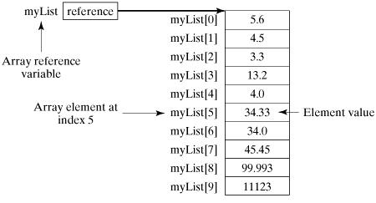
Arrays are also reference type: double[ ] myList; myList = new double[10]; Are arrays themselves objects? Sort of , it has : myList.length attribute

Slide 12
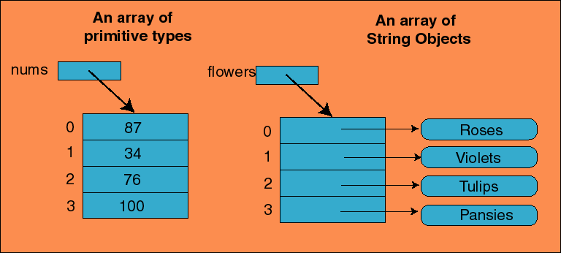
Arrays of Objects
Note that all REFERENCES are the same size, so each element in an array of any object is the same size.

Slide 13
Regular arrays are limited
How much of the array are we currently using?
How can we insert into:
The first, middle, last element of an array
How can we remove an element from:
The first element, middle, last element of an array?
How do we handle a full array when inserting?

Slide 14
Lab 1 demo

Slide 15
/** Task: Makes room for a new entry at newPosition.
*Precondition:1<=newPosition <= length+1;
*length is lists length before addition. */
private void makeRoom (int newPosition)
{
assert (newPosition >= 1) && (newPosition <= length + 1);
int newIndex = newPosition - 1;
int lastIndex = length - 1;
// move each entry to next higher index, starting at end of
// list and continuing until the entry at newIndex is moved
for (int index = lastIndex ; index >= newIndex ; index--){
list [index + 1] = list [index];
}
} // end makeRoom

Slide 16
/** Task: Shifts entries that are beyond the entry to be removed
*to the next lower position.
*Precondition:1<=givenPosition < length;
*length is lists length before removal. */
private void removeGap (int givenPosition)
{
assert (givenPosition >= 1) && (givenPosition < length);
int removedIndex = givenPosition - 1;
int lastIndex = length - 1;
for (int index = removedIndex ; index < lastIndex ; index++)
list [index] = list [index + 1];
} // end removeGap

Slide 17
ArrayList library datatype
Must import java.util.ArrayList;
ArrayList can grow as needed
Has lots of support methods: add(), remove(), etc.
Link to Oracle doc for ArrayList
ArrayList<String> list = new ArrayList<String>();
list.add(2,“Bob”); // second position
Is an Abstract Data Type (ADT)

Slide 18
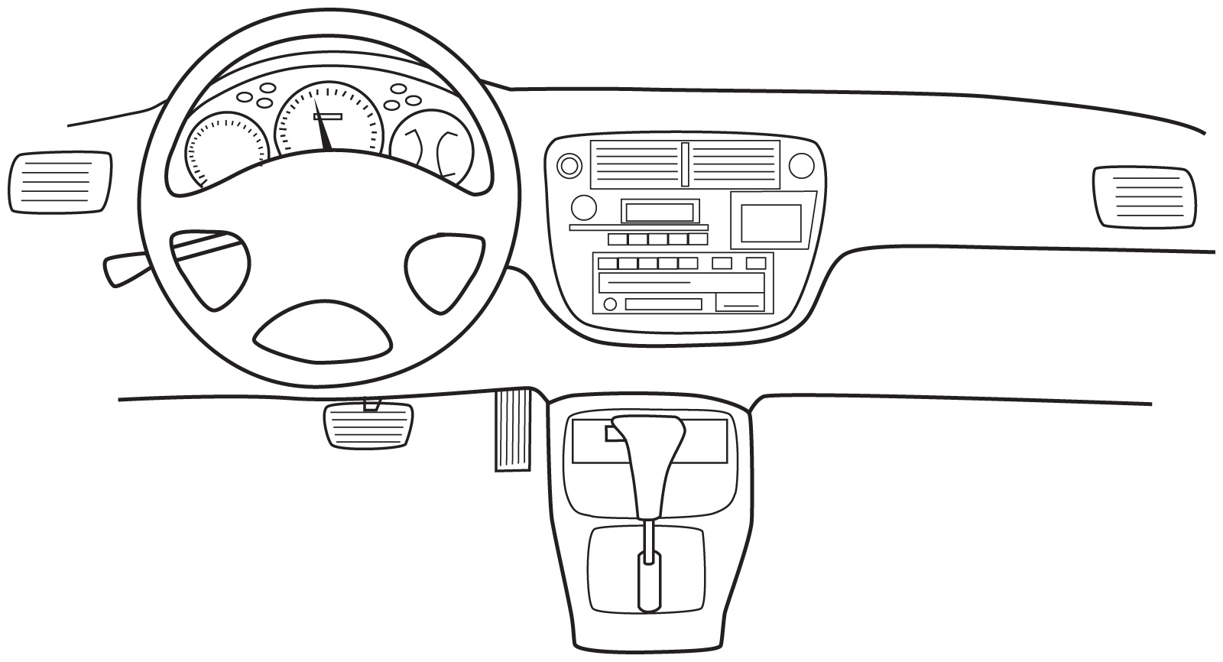
Abstraction
Hides the fine detail of the inner workings of the class
The implementation is hidden
Often called "information hiding”
An automobile's controls are visible to the driver, but its inner workings are hidden.

Slide 19
Abstract Data Type (ADT)
A collection of data
The operations on that data
It does NOT indicate how to store the data or implement the operations
Independent of any programming language
Data Structure = an implementation of an ADT in a programming language. For Java we use Interface and Class constructs.

Slide 20
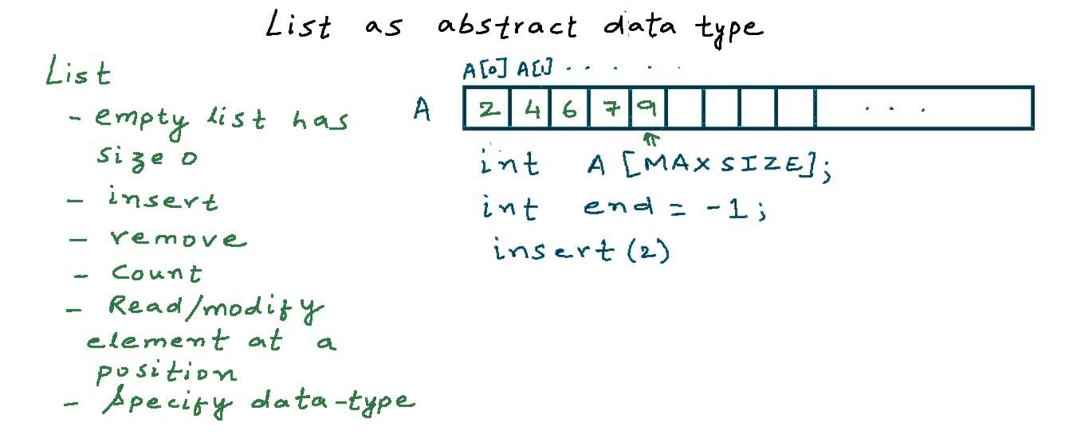
“An ADT is a data type that has operations and data that are not defined in the language itself.”
It is a type of object that stores and manipulates data on behalf of other classes in a project.
The implementation & representation details are hidden from the users of the ADT – hence “abstract.”

Slide 21
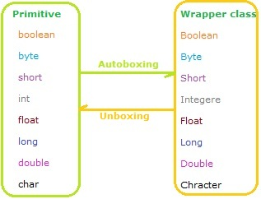
Wrapper Classes

Slide 22
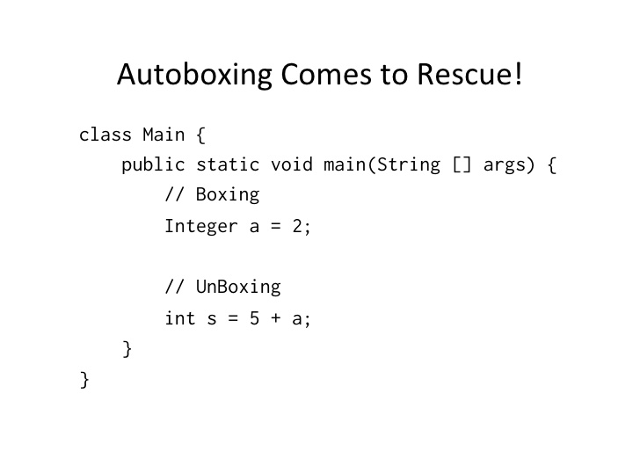
Wrapper Classes

Slide 23
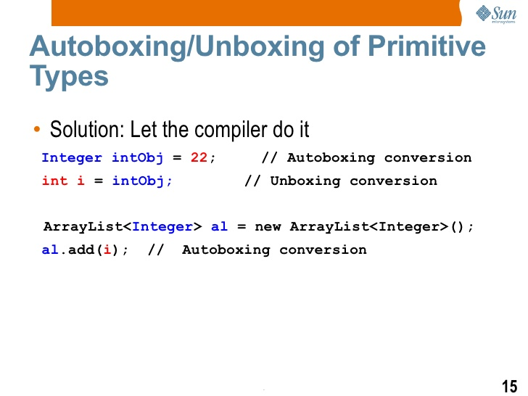
ArrayList holds only Object types

Slide 24
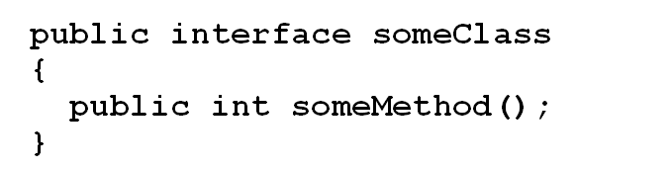
Designing an ADT: Java Interface
Hides the details of the class
Specifies a set of:
Public constants
Signatures for public methods (not code)
Comments that describe them
Begins like a class definition
Use the word interface instead of class

Slide 25
Implementing an Interface
A class that implements an interface must state so at start of definition with the implements clause.
Note: Interfaces are not strictly required for ADTs to operate but are good programming practice.

